Slide 1

Signal Sync - Smart Traffic Management System
Pranjali(124A8013)
Mayuri(124A8018)
Safa (124A8045)
Guide - Dr. Neethu Sabu

Slide 2
Presentation Outline
Introduction
Literature Survey
Proposed System
Methodology
Results
Conclusion
References

Slide 3
Introduction
Background
Traffic congestion is becoming a big problem in cities because the number of vehicles on the road is increasing every day. Most traditional traffic signals work on fixed time intervals, which means they do not change according to current traffic conditions.
Because of this:
Vehicles have to wait longer at signals
Traffic flow becomes slow and inefficient
Fuel consumption and pollution increase
With the development of intelligent transportation technologies, there is a need for smarter systems that can analyze traffic conditions and control signals dynamically.

Slide 4
Introduction
Purpose of the Project
The purpose of this project is to develop a smart traffic control simulation system for a four-way intersection.
The system compares two traffic control approaches:
Mathematical Predictive Model
Deep Reinforcement Learning (DRL) Model
The system analyzes traffic using parameters such as:
Queue length (number of waiting vehicles)
Waiting time
Throughput (vehicles passing the intersection)
By comparing these results, the project identifies which method manages traffic more efficiently.

Slide 5
Introduction
Relevance of the Project
This project is important for smart cities and intelligent transportation systems.
An efficient traffic control system can:
Reduce traffic congestion
Decrease travel time
Reduce fuel consumption
Improve road safety
The simulation created in this project also provides a safe environment to study traffic behavior and test different traffic control strategies before using them in real-world traffic systems.

Slide 6
Problem Statement
Traditional traffic signal systems cannot adjust signals based on real-time traffic. Due to this:
Traffic congestion increases
Vehicle queues become longer
Travel time increases
So, there is a need for a smart traffic system that can automatically adjust signal timing based on traffic conditions.
Need / Importance of the Project
An intelligent traffic control system can:
Reduce traffic congestion
Decrease vehicle waiting time
Improve traffic flow
Reduce fuel consumption and pollution
This is important for smart cities and intelligent transportation systems.

Slide 7
Objectives of the Project
The main objectives of this project are:
To create a traffic simulation for a four-way intersection.
To implement a mathematical traffic control model.
To implement a Deep Reinforcement Learning (DRL) traffic control agent.
To analyze traffic parameters such as:
Queue length
Waiting time
Traffic density
Throughput
To compare the performance of the mathematical model and the DRL model.

Slide 8
Literature Survey
Paper | Year | Key Findings | Limitations | Relevance to My Project
Python Documentation – Python Software Foundation [10] | 2025 | • Provides official documentation for Python programming • Supports development of simulation systems | • Not a research study • Mainly technical documentation | • Used for implementing the traffic simulation system • Supports Python‑based development
Simulation of Traffic Flow Using Python and Pygame – Pandey & Kumar [7] | 2024 | • Real‑time traffic visualization • Models vehicle movement and signals • Useful for testing traffic scenarios | • Not based on real‑world data • Limited realism | • Directly matches our project implementation • Supports scenario testing (Low / Balanced / Peak)
Urban Mobility Report – Schrank et al. [8] | 2022 | • Highlights global traffic congestion issues • Shows economic and environmental impact of congestion | • Does not provide specific technical solution | •Justifies need for improved traffic management systems
Reinforcement Learning: An Introduction – Sutton & Barto [3] | 2024 | • Provides theoretical framework for reinforcement learning • Explains learning‑based decision making algorithms | • Mostly theoretical concepts • Requires practical implementation | • Conceptual foundation for DRL‑based traffic signal optimization
Smart Traffic Light Control System Using Machine Learning – Lopes & Souza [6] | 2018 | • Uses ML to predict traffic flow • Dynamically adjusts signal timing | • Requires sensors and traffic monitoring infrastructure • High implementation cost | • Shows possibility of intelligent traffic signal control

Slide 9
Literature Survey
Research Gap
Limitations of Previous Work
Many previous studies focus on only one traffic control method, such as Reinforcement Learning or multi-agent systems.
Some traffic control approaches require complex infrastructure, high computational power, or large training data.
These systems are often difficult to implement and test at a student project level.
Identified Research Gap
Very few projects compare a mathematical traffic control model and a Deep Reinforcement Learning (DRL) model together.
Most studies do not evaluate both approaches under the same traffic conditions and performance metrics.
How Our Project Addresses This Gap
Our project compares both approaches in a single system.
A four-way traffic intersection simulator is used for testing.
Both models use:
the same traffic input data
the same safety rules
the same performance metrics
This allows a fair comparison to determine which method manages traffic more efficiently.

Slide 10
Proposed System
Overview of the Proposed Solution
The proposed system is a Smart Traffic Control System designed to simulate and optimize vehicle movement at a four‑way road intersection. The system compares two traffic control approaches:
Mathematical Predictive Model
Deep Reinforcement Learning (DRL) Model
Both models operate within the same traffic simulation environment, allowing a fair comparison of their performance under identical traffic conditions.
The system observes real‑time traffic parameters such as queue length, waiting time, and traffic density, and uses these parameters to determine which lane should receive the green traffic signal.
The goal of the proposed system is to reduce congestion, minimize waiting time, and improve traffic flow efficiency.

Slide 11
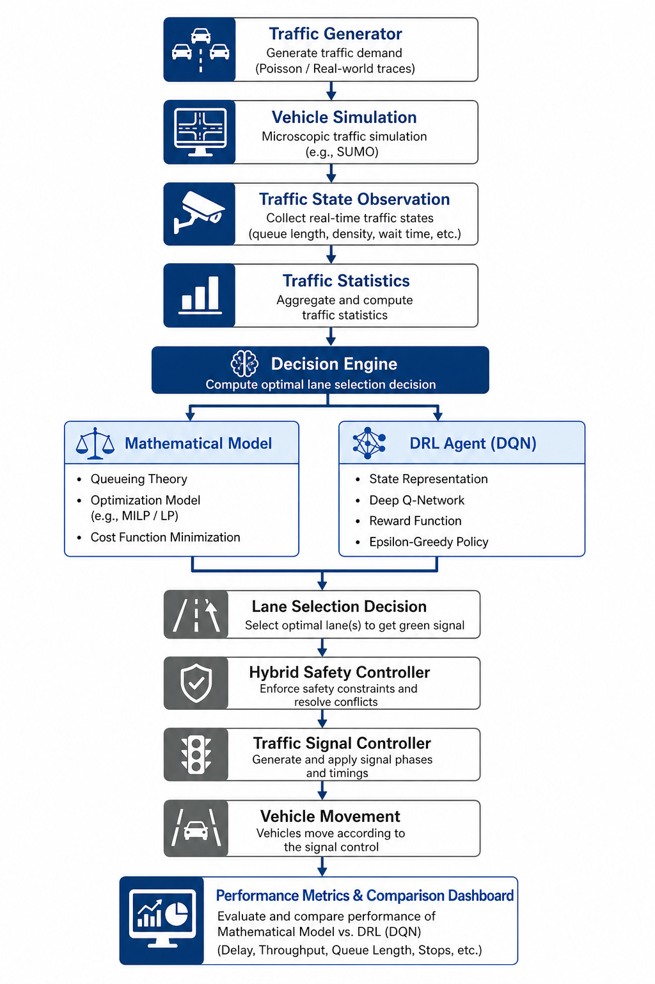
Proposed System Architecture Diagram

Slide 12
Methodology
Tools and Technologies Used
The proposed system was developed using the following tools and technologies:
Python – Main programming language used to implement the traffic simulation and control logic.
Pygame Library – Used to create the graphical traffic simulation interface and visualize vehicle movement.
NumPy – Used for numerical computations and traffic data processing.
Deep Reinforcement Learning (DQN) – Used to develop the intelligent traffic signal decision agent.
Mathematical Predictive Model – Implemented for rule‑based traffic signal control and comparison.

Slide 13
Methodology
The project follows a structured methodology consisting of the following steps:
1. Traffic Generation
Vehicles are generated dynamically from four directions (North, South, East, West). Traffic scenarios such as Low, Balanced, and Peak traffic determine the vehicle generation rate.
2. Traffic Simulation
A four‑way intersection environment is simulated where vehicles move according to traffic rules such as stopping at red signals and moving during green signals.
3. Traffic State Observation
The system continuously monitors traffic conditions and calculates parameters such as:
Queue Length
Waiting Time
Traffic Density
These values represent the current traffic state.

Slide 14
Methodology
4. Decision Making
Traffic signal control decisions are made using two approaches:
Mathematical Predictive Model based on queue length and waiting time.
Deep Reinforcement Learning Agent using a Deep Q Network.
5. Safety and Signal Control
A hybrid safety controller ensures fairness by preventing excessive waiting time and maintaining stable traffic flow.
6. Performance Evaluation
The system evaluates traffic efficiency using performance metrics such as:
Average Waiting Time
Maximum Waiting Time
Throughput
Average Queue Length
The results from both models are compared using a performance dashboard.

Slide 15
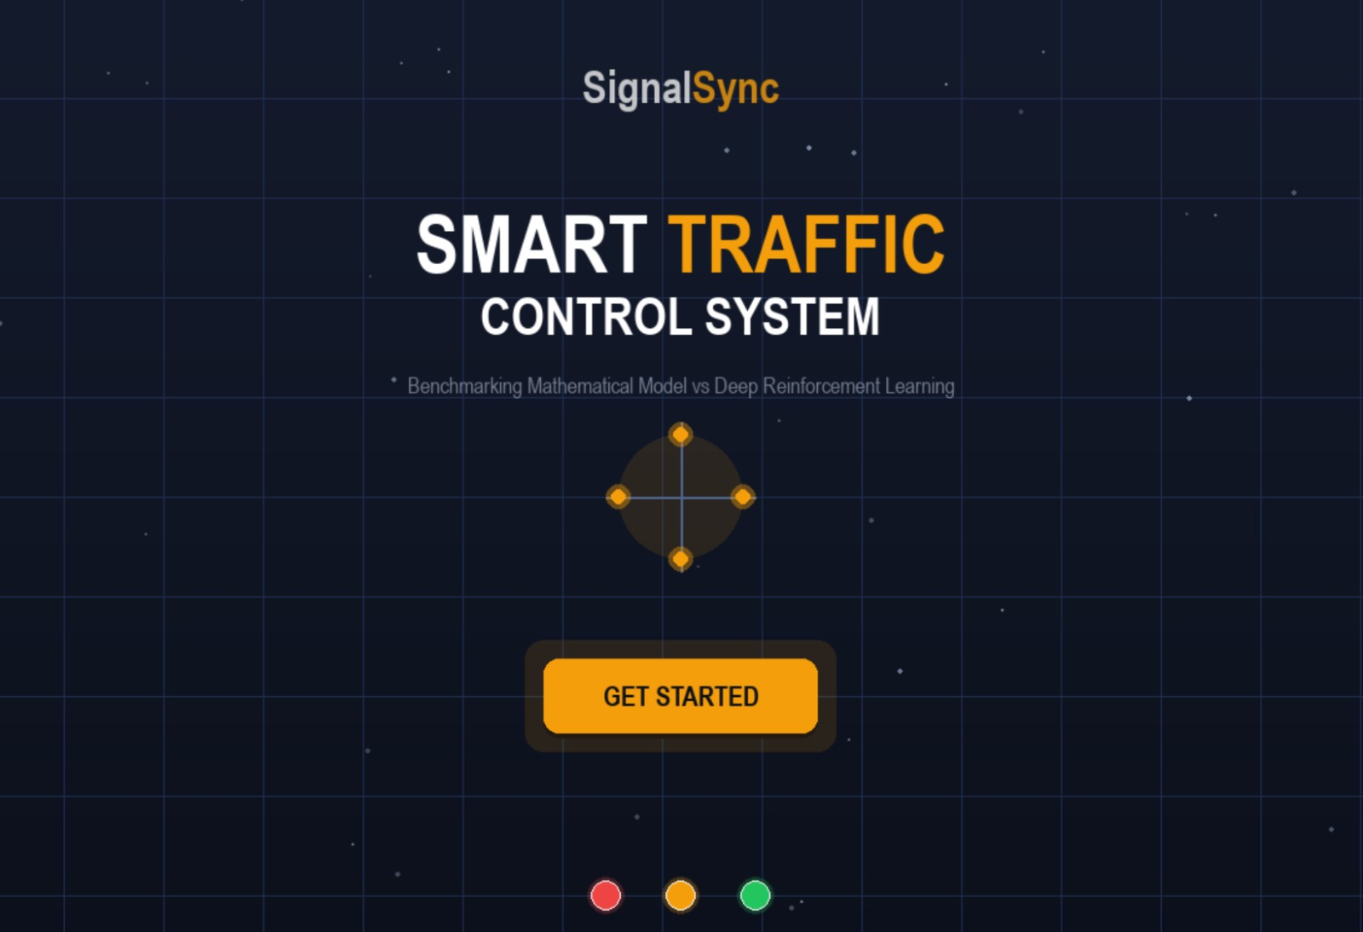
Results
Simulation Results
The system evaluates the performance of two traffic control approaches:
Mathematical Predictive Model
Deep Reinforcement Learning (DRL) Model
Both models were tested under identical traffic conditions using the Balanced traffic scenario.
Each model was executed for 60 seconds, and the system recorded multiple traffic performance metrics.
Project Landing Screen This screen shows the SignalSync system interface where the traffic simulation starts.

Slide 16
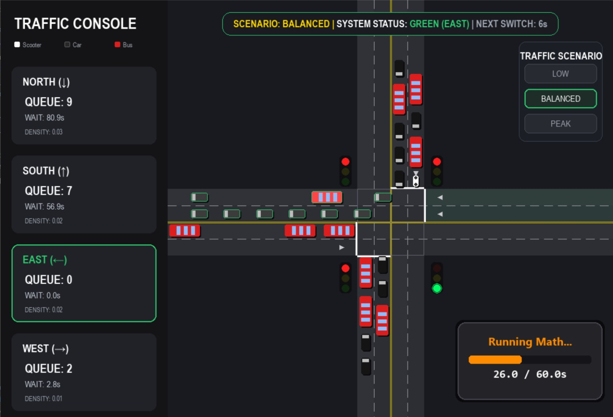
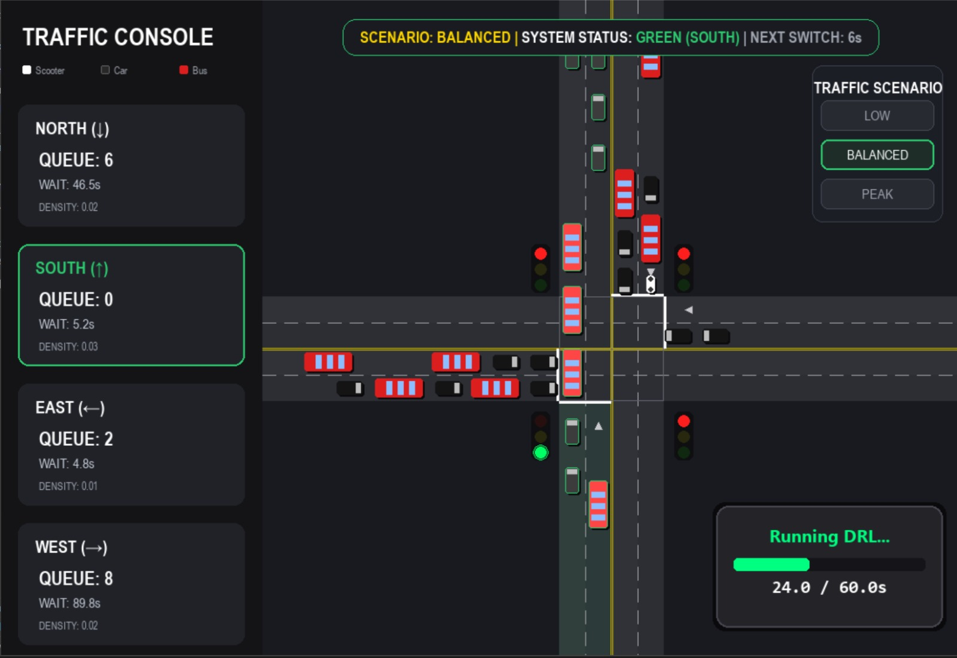
Results
Mathematical Model Simulation This image shows the traffic simulation running with the mathematical traffic control model managing the signals.
DRL Model Simulation This image shows the traffic simulation controlled by the Deep Reinforcement Learning (DRL) agent.

Slide 17
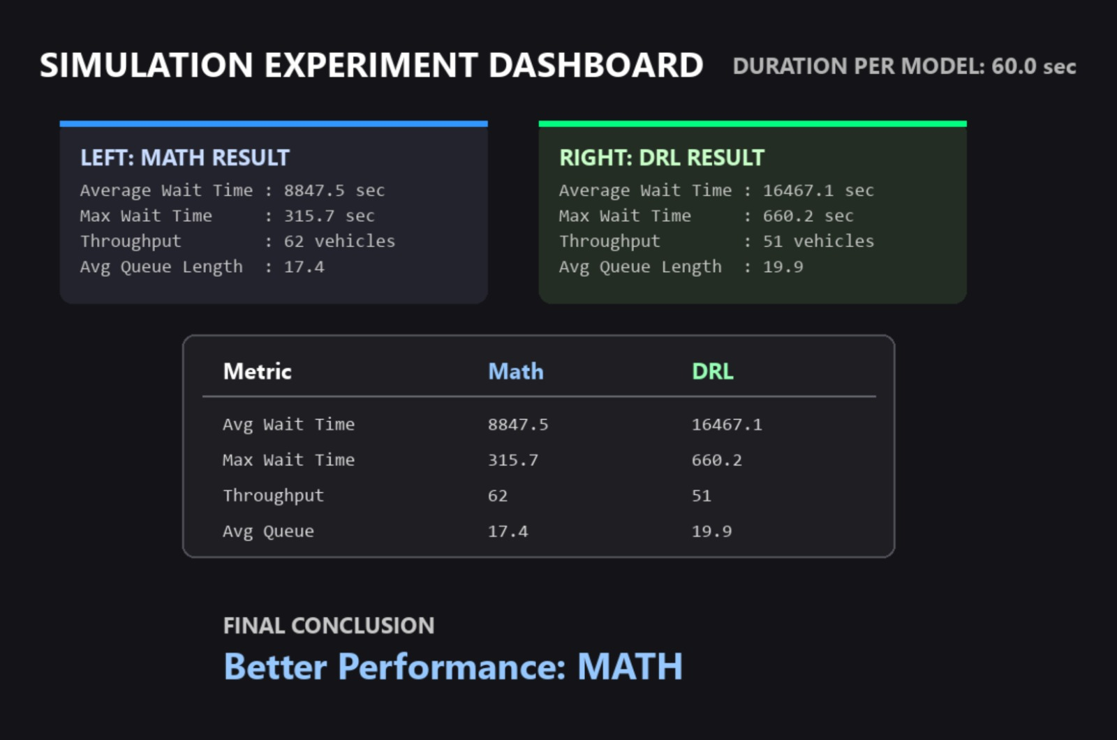
Results
Performance Metrics Used
The following metrics were used to evaluate the efficiency of each model:
Average Waiting Time – Average time vehicles wait at signals
Maximum Waiting Time – Longest waiting time experienced by any vehicle
Throughput – Total number of vehicles passing the intersection
Average Queue Length – Average number of vehicles waiting at signals

Slide 18
Conclusion
Our project successfully developed a smart traffic signal control system for a four-way intersection that compares a Mathematical predictive model and a Deep Reinforcement Learning agent under the same simulation conditions. Based on the evaluated metrics, the Mathematical model performed better in the current experiment by achieving lower waiting time, lower queue length, and higher throughput. The project also demonstrated the importance of combining intelligent decision-making with a hybrid safety controller to ensure fairness and prevent traffic starvation.
Key takeaways
A full traffic control system must include simulation, decision-making, safety control, and performance evaluation.
Rule-based mathematical control can still outperform DRL when the DRL agent is not fully optimized or sufficiently trained.
DRL remains a promising approach for future adaptive traffic management in more dynamic environments.

Slide 19
Future scope
The proposed smart traffic control system can be further improved and expanded in several ways to enhance its performance and real‑world applicability.
Improved DRL Training: The Deep Reinforcement Learning model can be trained with larger datasets and longer training episodes to achieve better decision‑making and traffic optimization.
Real‑Time Traffic Data Integration: The system can be connected with real‑time traffic sensors, cameras, or IoT devices to obtain live traffic data and dynamically adjust signal timings.
Multi‑Intersection Traffic Management: The model can be extended to manage multiple connected intersections, enabling coordinated traffic signal control across an entire road network.
Emergency Vehicle Priority: Future versions can include priority mechanisms for ambulances, fire trucks, and emergency vehicles to reduce response time.
Smart City Integration: The system can be integrated with smart city transportation infrastructure to support intelligent traffic monitoring and urban mobility planning.
Mobile or Web Dashboard: A web or mobile application can be developed to monitor traffic conditions and control signals remotely

Slide 20
References
K. Dresner, P. Stone,“A Multiagent Approach to Autonomous Intersection Management,” Journal of Artificial Intelligence Research, Vol. 31, pp. 591–656, 2014.
L. Li, Y. Lv, F. Wang, “Traffic Signal Timing via Deep Reinforcement Learning,” IEEE/CAA Journal of Automatica Sinica, Vol. 3, No. 3, pp. 247–254, 2016.
R. S. Sutton, A. G. Barto, Reinforcement Learning: An Introduction, MIT Press, 2nd Edition, 2024.
M. Abdoos, N., Mozayani, A. L. C. Bazzan,“Holonic Multi‑Agent System for Traffic Signals Control,” Engineering Applications of Artificial Intelligence, Vol. 26, pp. 1575–1587, 2016.
S. El‑Tantawy, B. Abdulhai, H. Abdelgawad,“Multi‑Agent Reinforcement Learning for Integrated Network of Adaptive Traffic Signal Controllers,” Transportation Research Part C, Vol. 58, pp. 146–163, 2015.
C. G. B. Lopes, B. E. A. P. Souza, “Smart Traffic Light Control System Using Machine Learning,” International Journal of Computer Applications, Vol. 179, No. 7, pp. 20–25, 2018.
A. K. Pandey, S. Kumar, “Simulation of Traffic Flow Using Python and Pygame,” International Journal of Engineering Research & Technology, Vol. 9, No. 5, pp. 120–124, 2024.
D. Schrank, B. Eisele, T. Lomax, Urban Mobility Report, Texas A&M Transportation Institute, 2022.
G. K. Zipparapu, A. R. K. Sastry, “Adaptive Traffic Signal Control Using Reinforcement Learning,” IEEE Conference on Intelligent Transportation Systems, pp. 1–6, 2018.
Python Software Foundation, Python Documentation, Official Documentation, 2025.

